Slide 1




Aligned with Egypt's Vision 2030, the Digital Egypt Pioneers Initiative (DEPI) by the Ministry of Communications and Information Technology (MCIT) aims to develop specialized ICT professionals. This initiative emphasizes software testing as key to ensuring high-quality digital solutions, supporting Egypt’s goal of a competitive digital economy and technological advancement.

Slide 2
Supervisor: Eng. George Atia Nafady
Ahmed Adel Hassan (21023270)
George Bassem Taqi (21024126)
Ahmed Mohamed Abdelhamed (21008297)
Manar Ali (21029143)
Nadeen Alaa (21029146)
Aligned with Egypt's Vision 2030, the Digital Egypt Pioneers Initiative (DEPI) by the Ministry of Communications and Information Technology (MCIT) aims to develop specialized ICT professionals. This initiative emphasizes software testing as key to ensuring high-quality digital solutions, supporting Egypt’s goal of a competitive digital economy and technological advancement.

Slide 3


Comprehensive Testing Framework for E-Commerce Websites

Slide 4


Overview of the project
Graduation Project in Software Testing for the Digital Egypt Pioneers Initiative (DEPI) involves participants applying advanced testing techniques to real-world applications. This project is integrated with another web development project within DEPI, where one team develops a web application and another team is responsible for testing it.

Slide 5

Why we choose Integration
Enhanced Planning Skills
Real-World Collaboration
Comprehensive Understanding
Project Management Experience
This collaborative approach not only enhances technical skills but also prepares participants for the multidisciplinary coordination required in professional software projects.
Testing
DEV

Slide 6
Goals & Motivation for the Project:
Goals
Motivations
Ensure Software Quality: Implement a robust testing process to verify the functionality, security, and performance of the web application.
Early Defect Detection: Identify defects early in the development cycle to reduce costs and improve product quality.
Enhance Collaboration: Improve communication between developers and testers through integrated workflows, ensuring a smooth software lifecycle.
Address Real-World Challenges: The need for high-quality software is critical in today's digital economy, and many projects suffer from late-stage defect detection and poor testing coverage.
Align with Egypt’s Vision 2030 and DEPI: The project is motivated by the national goal to develop skilled professionals in the ICT sector, contributing to the growth of the digital economy.

Slide 7

Previous Research or Solutions:
Agile Testing:
More recent methodologies, such as Agile, integrate testing into each development sprint, allowing for continuous feedback and earlier defect identification. This approach enhances collaboration between testers and developers but can sometimes lack detailed documentation or structured testing plans.

Slide 8



Technologies reviewed:
Excel/Google Sheets (Test Case Tracking):
Purpose: Simple and customizable tool for maintaining test cases and recording results.
Benefits: Flexibility in creating test cases and ease of sharing with the team.
Usage in Manual Testing: Often used for documenting test cases, logging results, and tracking the status of each test without relying on dedicated tools.
Postman (API Testing – Manual):
Purpose: Used to manually test APIs by sending requests and reviewing responses.
Benefits: Allows testers to manually validate API functionality, response time, and data handling.
Usage in Manual Testing: Commonly used for testing RESTful APIs during manual test cycles to ensure proper backend functionality.

Slide 9
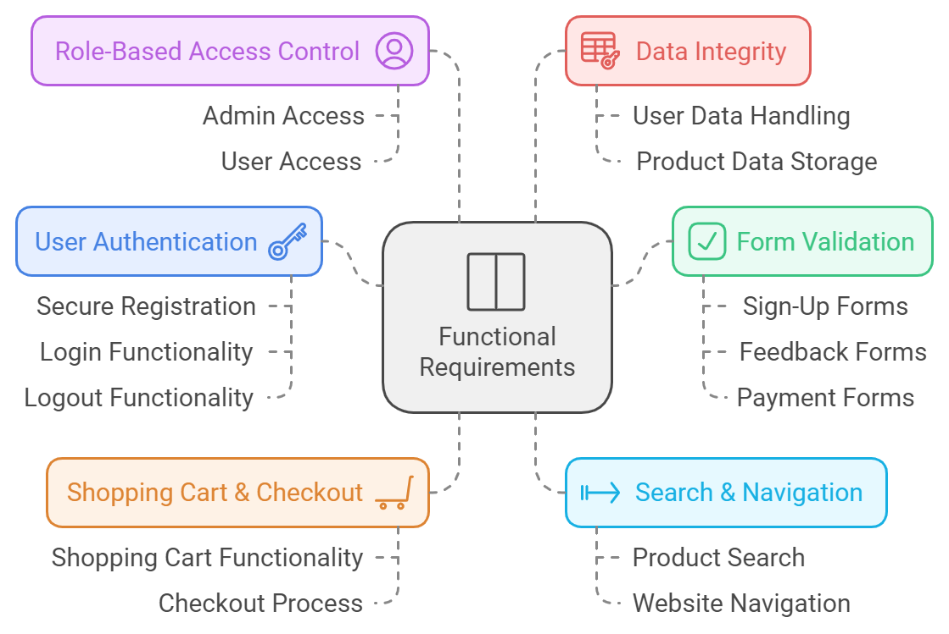
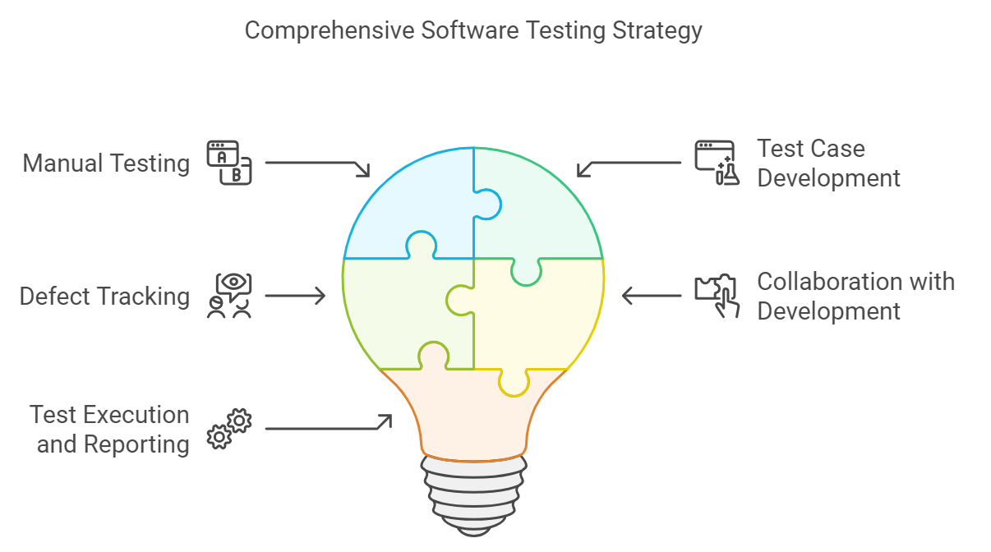
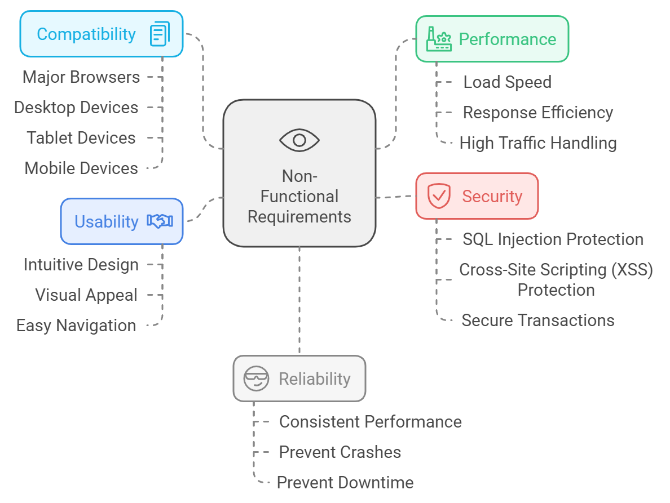

Project Scope and Requirements

Slide 10
Functional and non-functional requirement
Testing

Slide 11


Testing

Slide 12
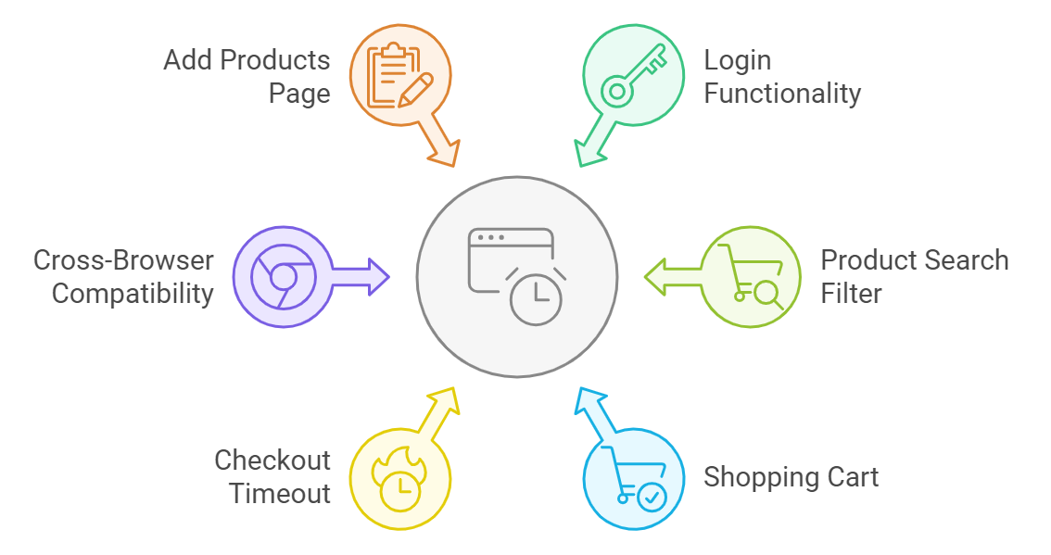

Overview of system
Testing

Slide 13
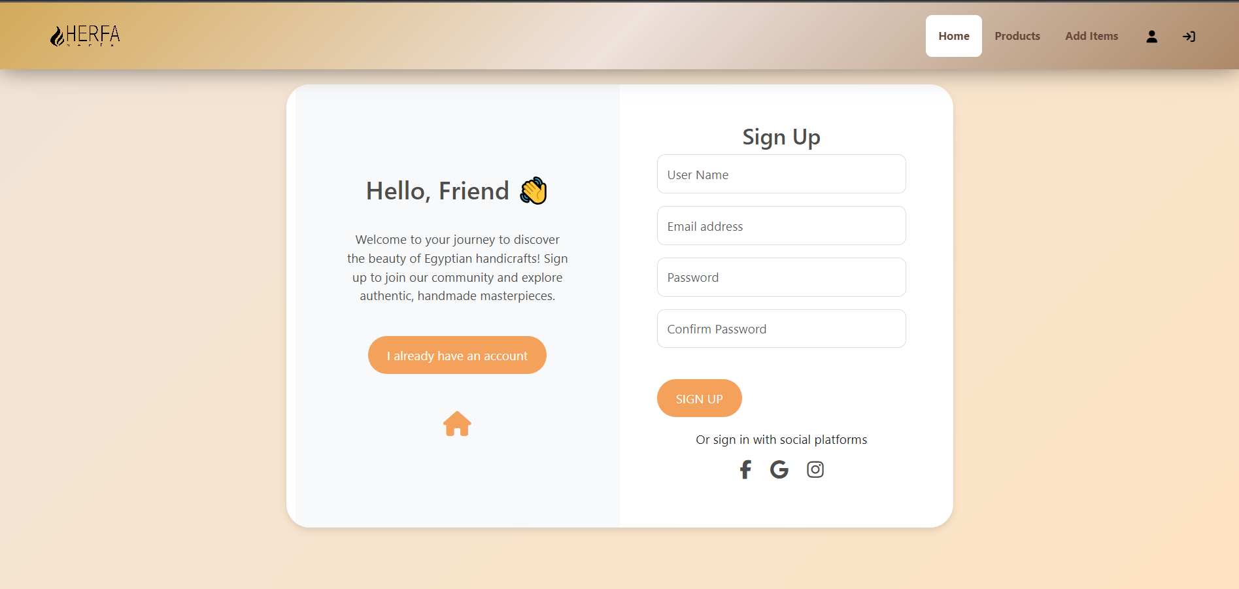
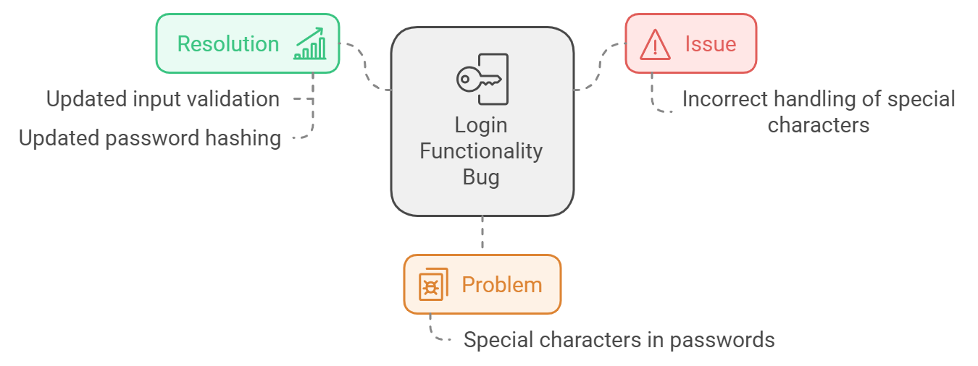
Login Functionality Bug

Slide 14
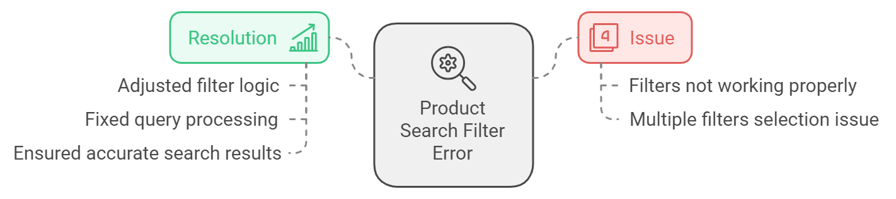
Product Search Filter Error:

Slide 15
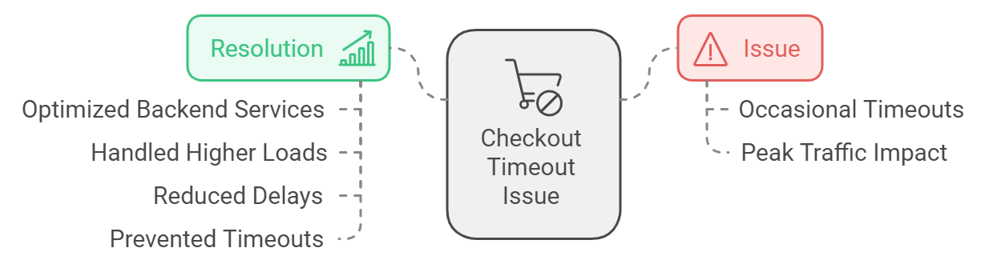
Shopping Cart Quantity Bug:

Slide 16
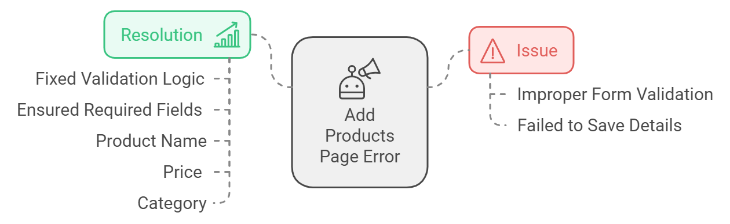
Add Products Page Error:

Slide 17
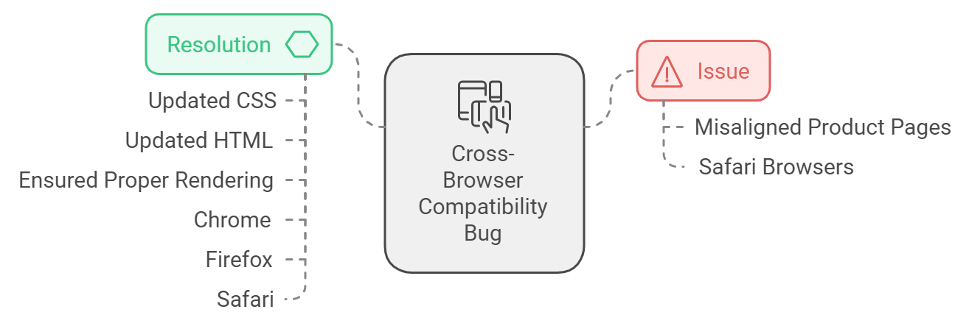
Cross-Browser Compatibility Bug:

Slide 18


Challenges & Project Marketing

Slide 19

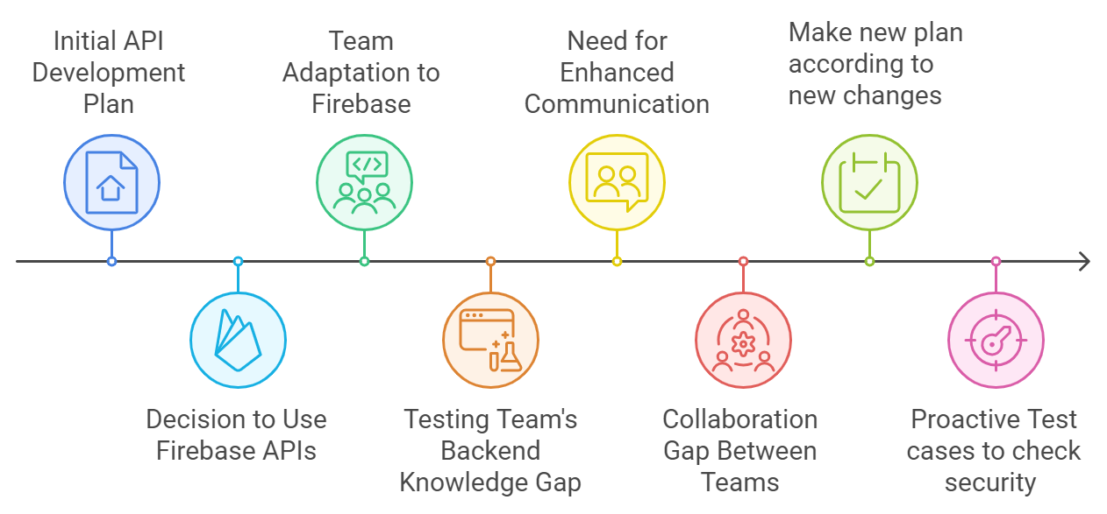
Development Challenges During the Project: Unexpected Shifts in the Development Plan

Slide 20
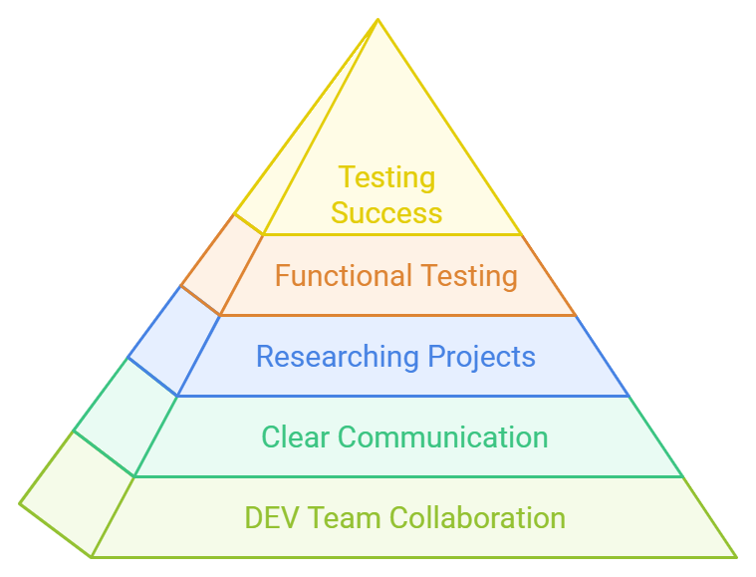
Development Challenges During the Project: Firebase

Slide 21
Our Solutions
Leveraging DEV Team Expertise:
Solution: We closely collaborated with the DEV team, requesting detailed screenshots and feature descriptions to better understand the functionalities without direct backend access.
Studying Similar Projects:
Solution: To bridge the knowledge gap, we researched similar projects that utilized Firebase APIs. This provided us with insights into common issues and use cases, which we adapted to our testing strategy.
Clear Communication with DEV Team:
Solution: We implemented regular check-ins and streamlined communication channels between the testing and development teams. We discussed new features and clarified how changes impacted the testing requirements.
Functional and Integration Testing for Firebase:
We focused on functional testing to ensure that the new Firebase API features were working as expected.

Slide 22
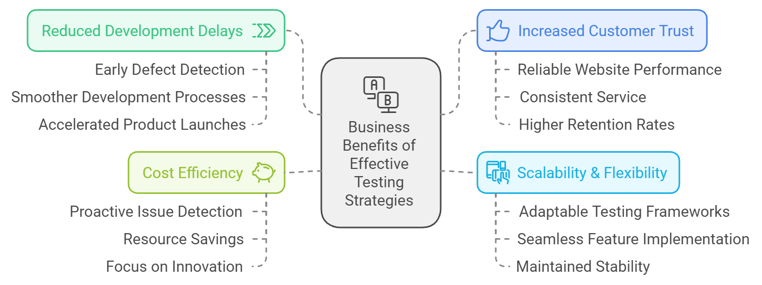
Marketing & Business Impact of Adaptable Testing: Turning Challenges into Opportunities
Business Benefits:
Reduced Development Delays: Early detection of defects leads to smoother development cycles and faster product launches.
Increased Customer Trust: Reliable website performance ensures a positive customer experience, boosting satisfaction and retention.
Scalability & Flexibility: Adaptable testing frameworks make it easier to implement new features and expansions without causing website instability.
Cost Efficiency: Proactive issue detection saves resources on post-launch fixes and customer complaints.

Slide 23
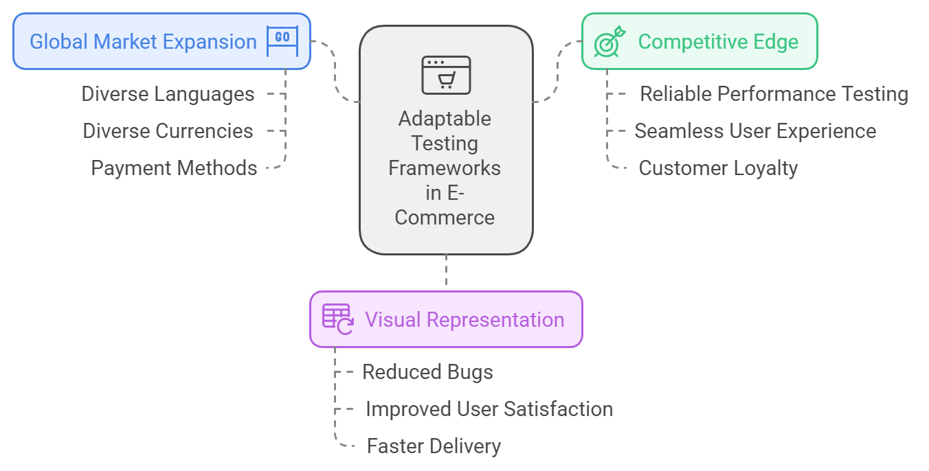
Marketing & Business Impact of Adaptable Testing: Turning Challenges into Opportunities
Opportunities Created:
Global Market Expansion: Ensures readiness for e-commerce websites to handle global traffic and international customers.
Competitive Edge: Reliable performance testing helps e-commerce businesses stand out by offering a seamless and dependable user experience.
Visual:
Include a graphic showing a comparison of "Before & After" of adopting adaptable testing frameworks (e.g., reduced bugs, improved user satisfaction, faster delivery).

Slide 24

Thank You
Any Questions ?

